Slide 1
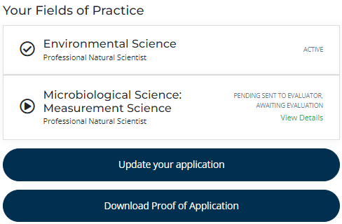
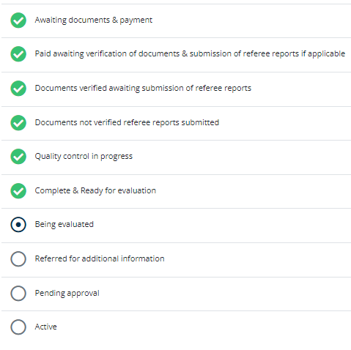
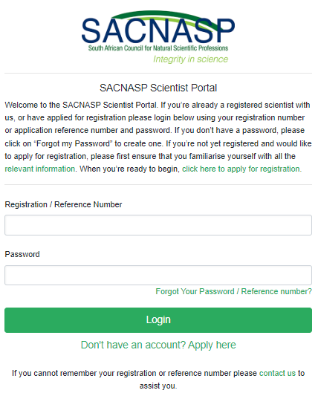
What is the status of my application?
Step 1
On the SACNASP website, click on “Log In”
Step 2
Click on “View Details”
Step 3
You are done!
Message to accompany infographic:
Dear applicant,
SACNASP will endeavour to process your application within 3-6 months. We are aware that there may be applications exceeding this time frame. Please note that we have put measures in place, and are placing additional measures to address the backlog in Agricultural Sciences.

Slide 2
Step 1
On the SACNASP website, click on “Log In”
Step 2
Click on “View Details”
Step 3
You are done!

